Slide 1
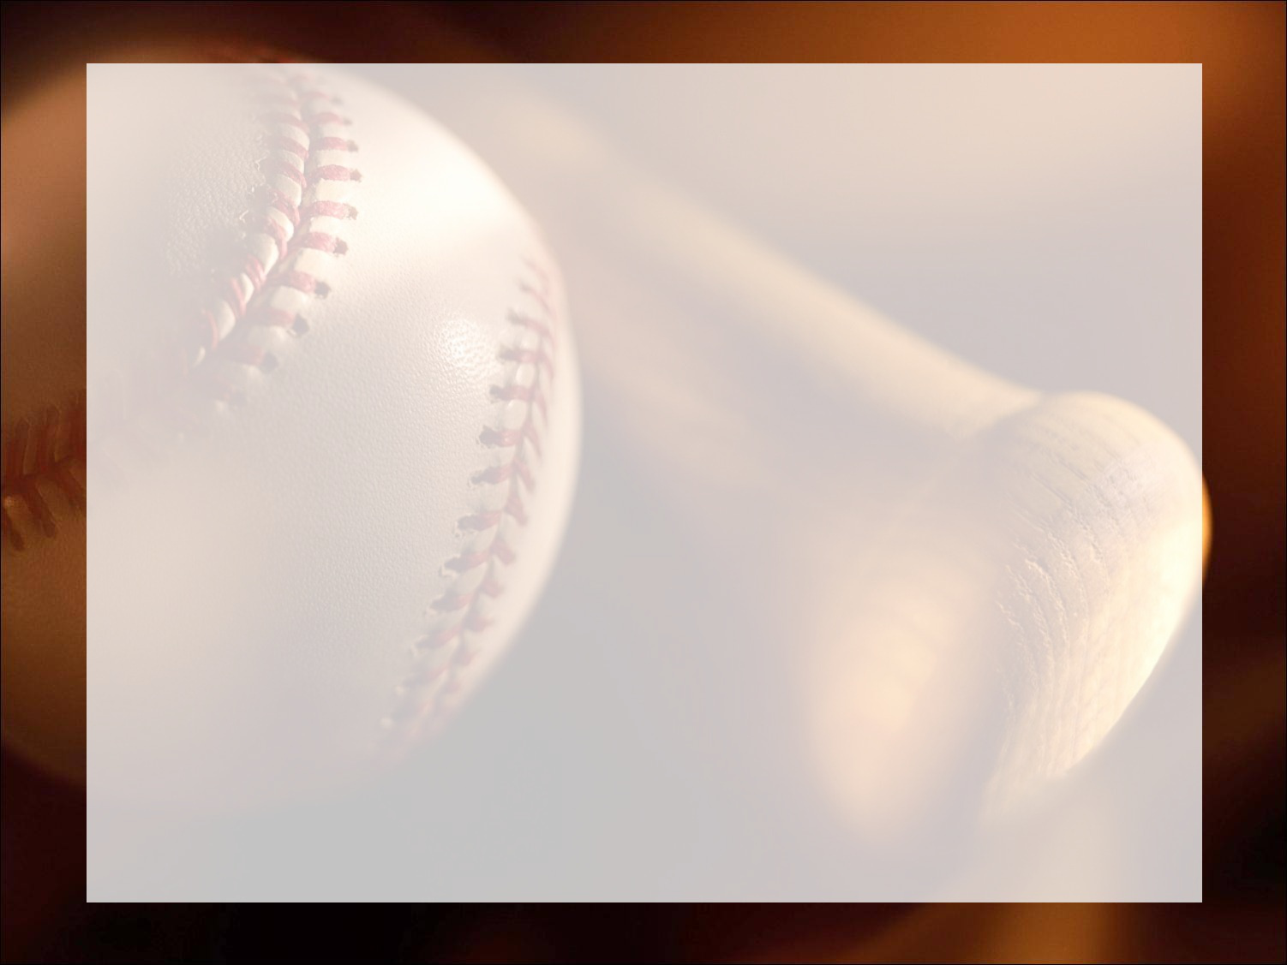

Loyola University - Chicago
2017 SABR Case Competition
Brian Ahern, Daniel Hansen, Donner Kahl,
Andrew Pawlowski, Donald Stolz

Slide 2
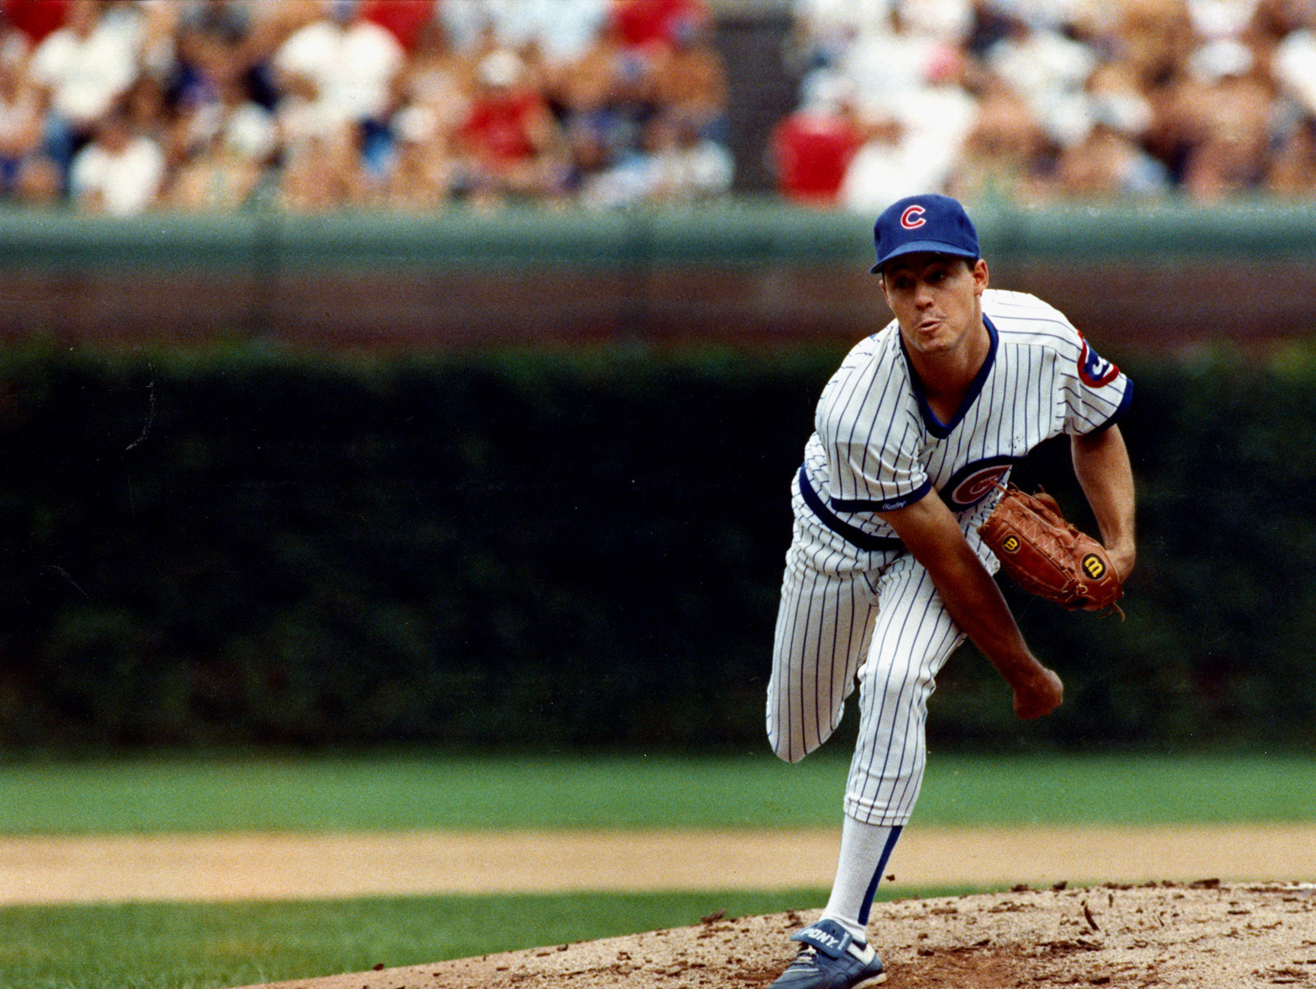
Pitch Tunneling & Sequencing
“You see a pitch inside and wonder, 'Is it the fastball or the cutter?' That's where he's got you.” - Tony Gwynn
“Sometimes he knows what he's going to throw two pitches ahead.”- John Smoltz
Notes:
Greg Maddox, Hall of Fame pitcher who didn’t throw heat. Was able to make each look the same until it was impossible to react

Slide 3
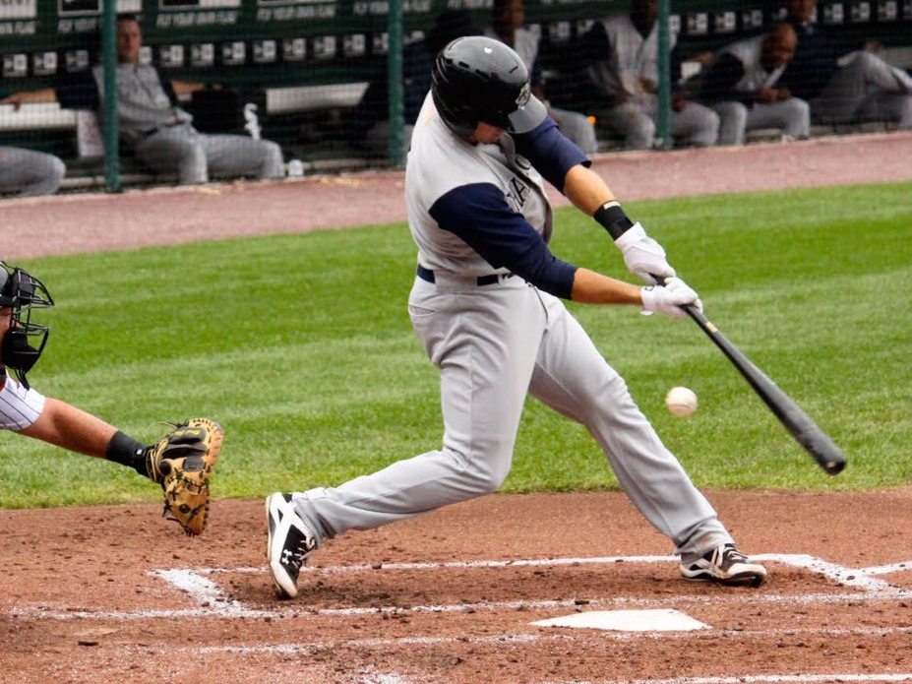
The Problem for Hitters
“Hitting a baseball is the single most difficult thing to do in sport.” - Ted Williams
“The good hitters get their tip-off from the pitchers.”
- Charley Metro
Notes:
Difficult because hitting a baseball traveling already on edge of human reaction limits. The hitters are forced to base swings off tells from the pitcher, it’s critical for pitchers to hide their tells

Slide 4
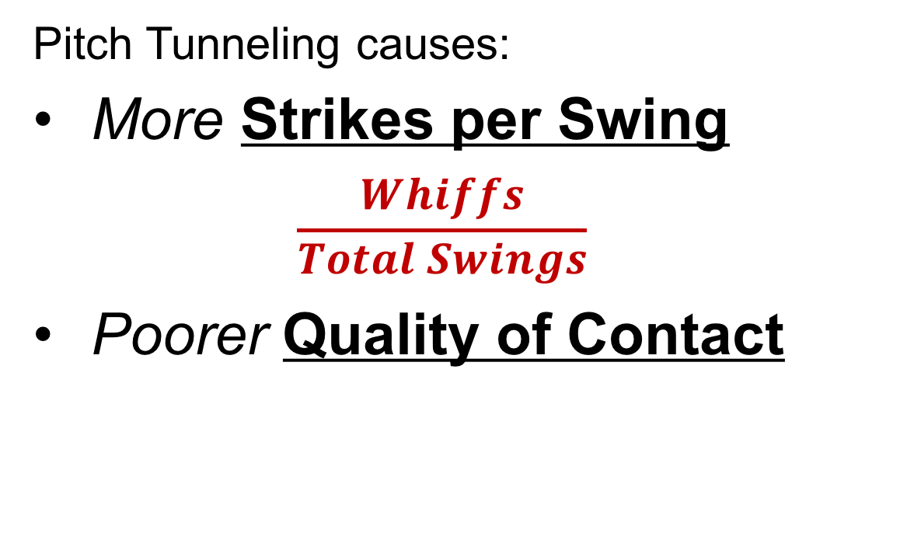
The Hypothesis
Pitch Tunneling causes:
More Strikes per Swing
$$\frac{Whiffs}{Total Swings}$$
Poorer Quality of Contact

Slide 5
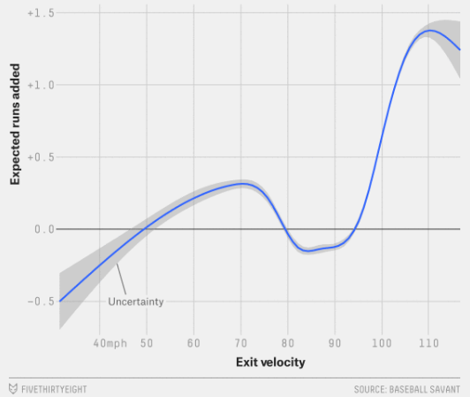
Quality of Contact
A pitcher that tunnels well should limit quality of contact
- Average Velocity as well as
Average launch angle was
Taken for each sequence thrown
-This gives a better idea of the
results of an at bat than just
the actual outcome

Slide 6
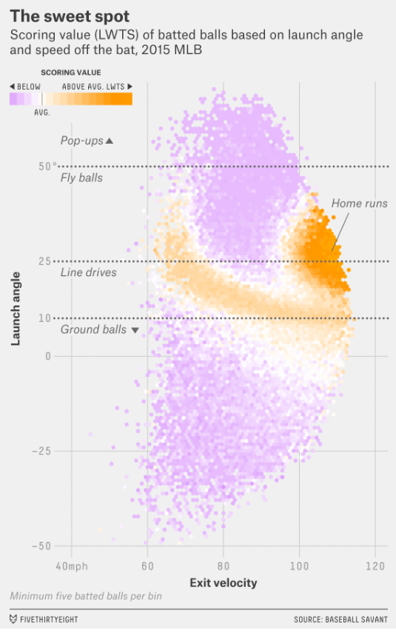
Quality of Contact
Measured Ground Ball %, Fly Ball %,
and Line Drive %
Hypothesize that a
better tunneling
metrics result in
worse launch angles

Slide 7
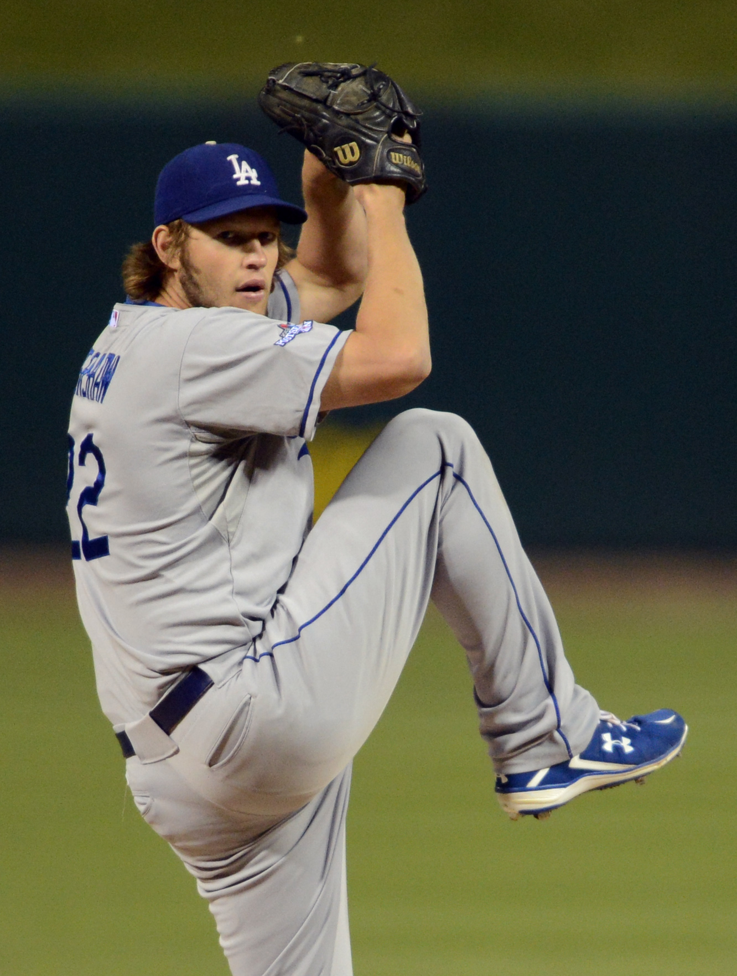
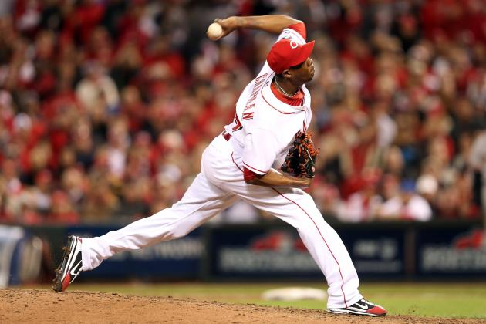
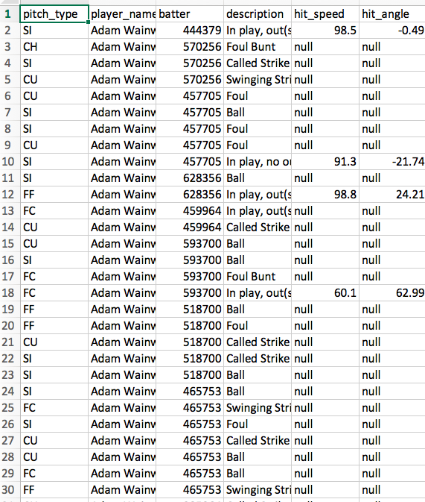
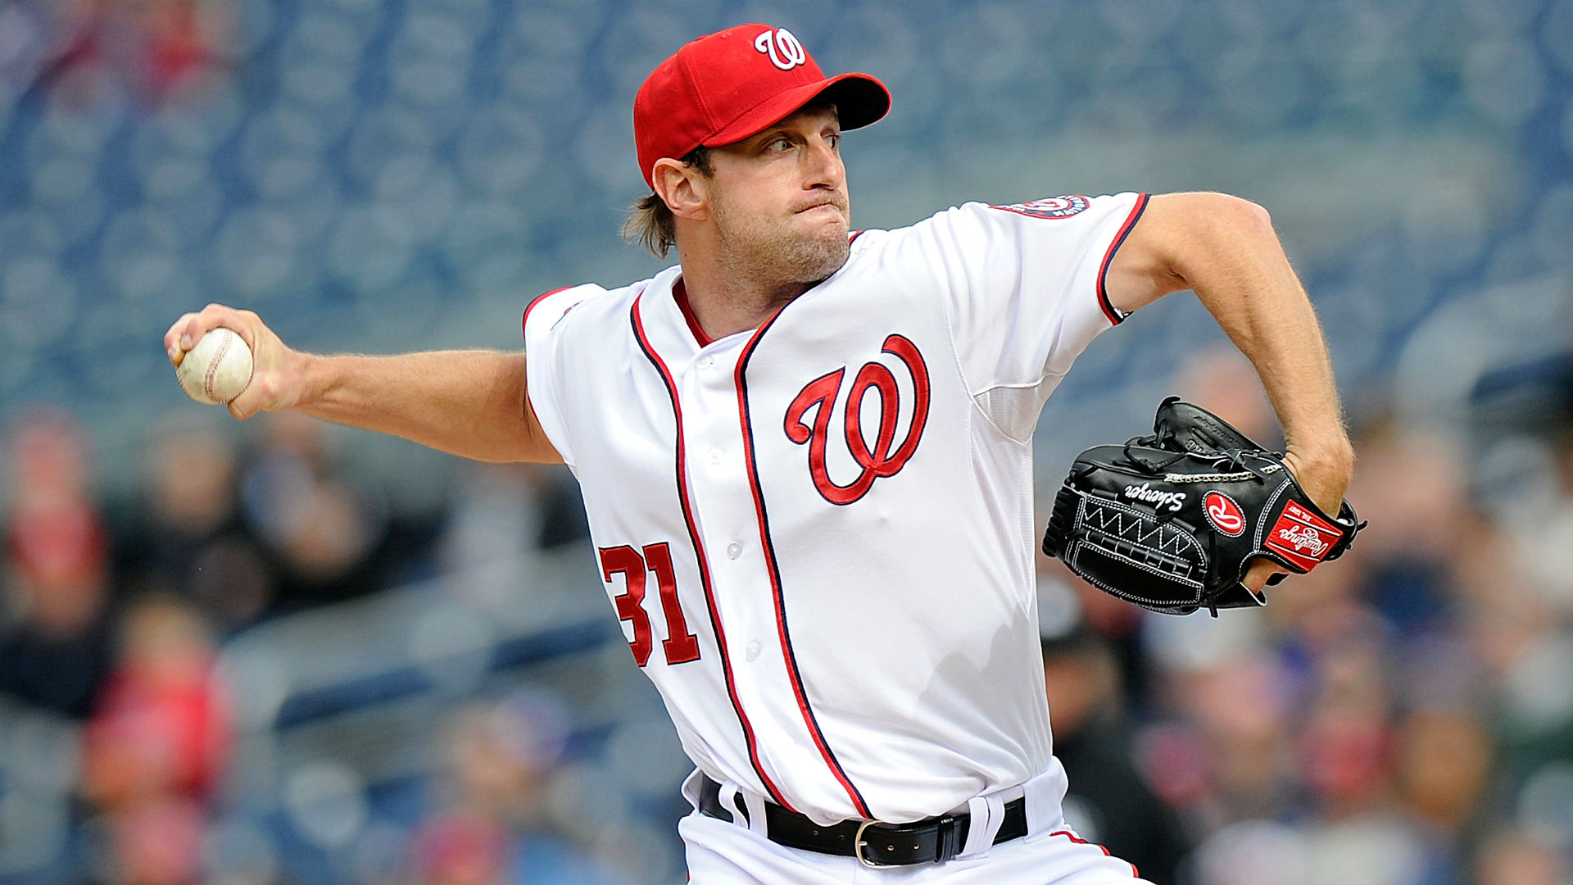
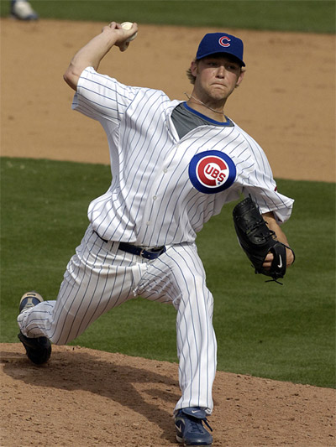
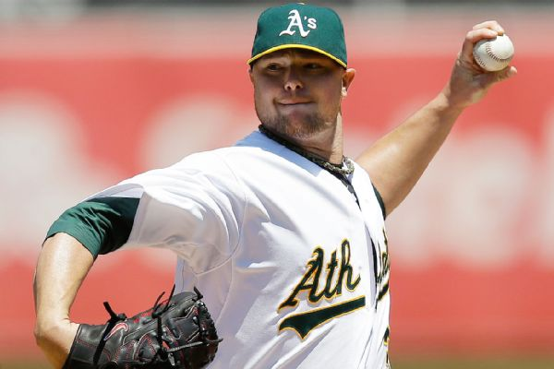
Data Selection
55 Random Pitchers
5 Hand-picked Elite Pitchers
Prospectus – Sequencing
Statcast – Individual Pitch Data
Notes:
92,372 pitches Selected 55 pitchers for our random sample size. Also picked pitchers we felt demonstrated strong pitch tunneling ability

Slide 8
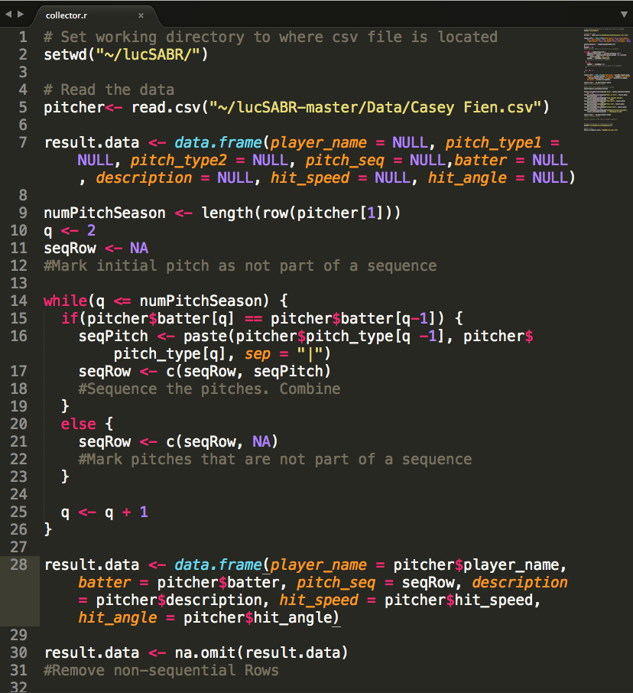
The Collection Process
2016 Season
Every pitch by pitcher
Collect Sequences
Filter swings
Perform calculations by pitch sequences
Separate Best & Worst Tunnelers
Notes:
Collected 2016 season hit_speed, hit_angle, and event description. Sorted sequences by at bats. Filtered into only pitches swung at Fouls, & swinging strikes. Calculated hit ground%, lineDrive%, flyBall% 92,372 pitches

Slide 9
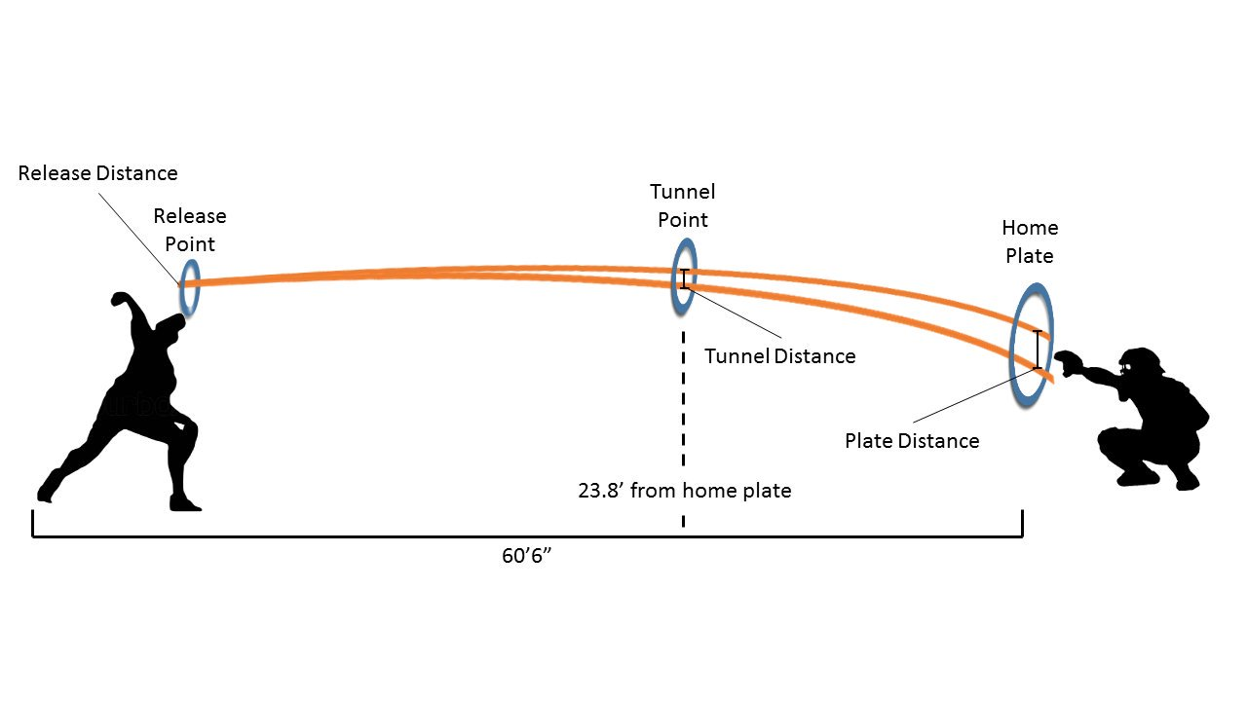
Pitch Tunneling Metrics
Notes:
Pitch tunneling measures how well pitchers can disguise their pitches.

Slide 10
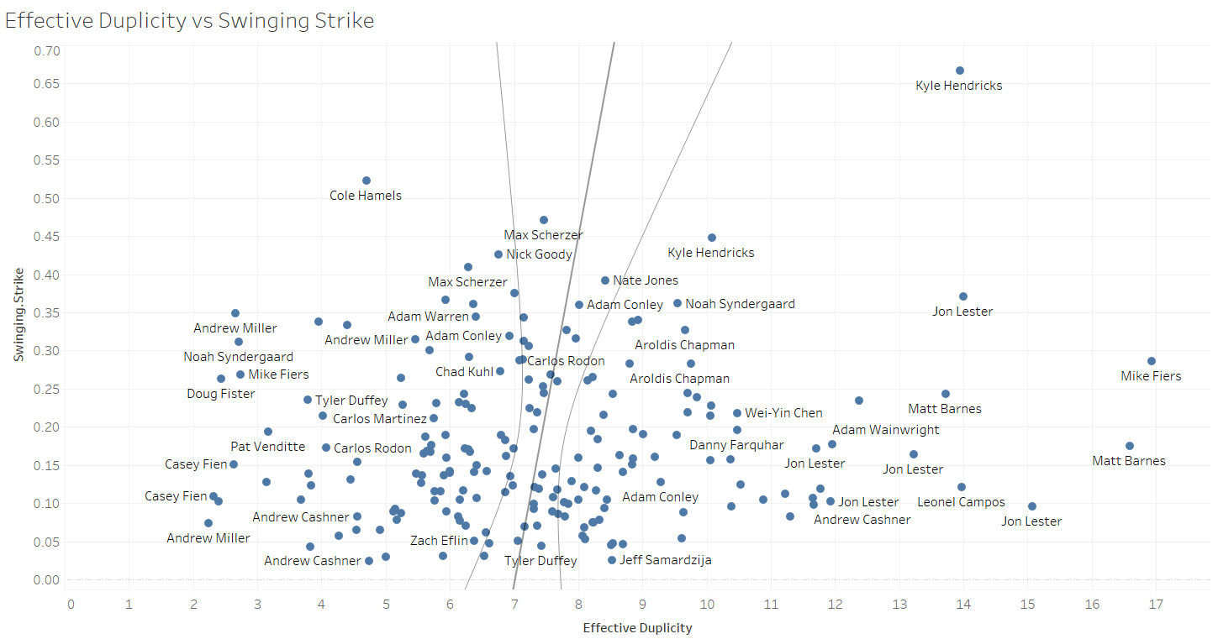
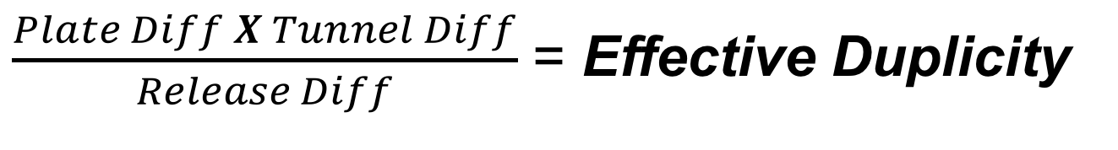
Measuring Tunnel Quality
$\frac{Plate Diff X Tunnel Diff}{Release Diff}$ = Effective Duplicity
Notes:
Measures a pitchers best sequence

Slide 11
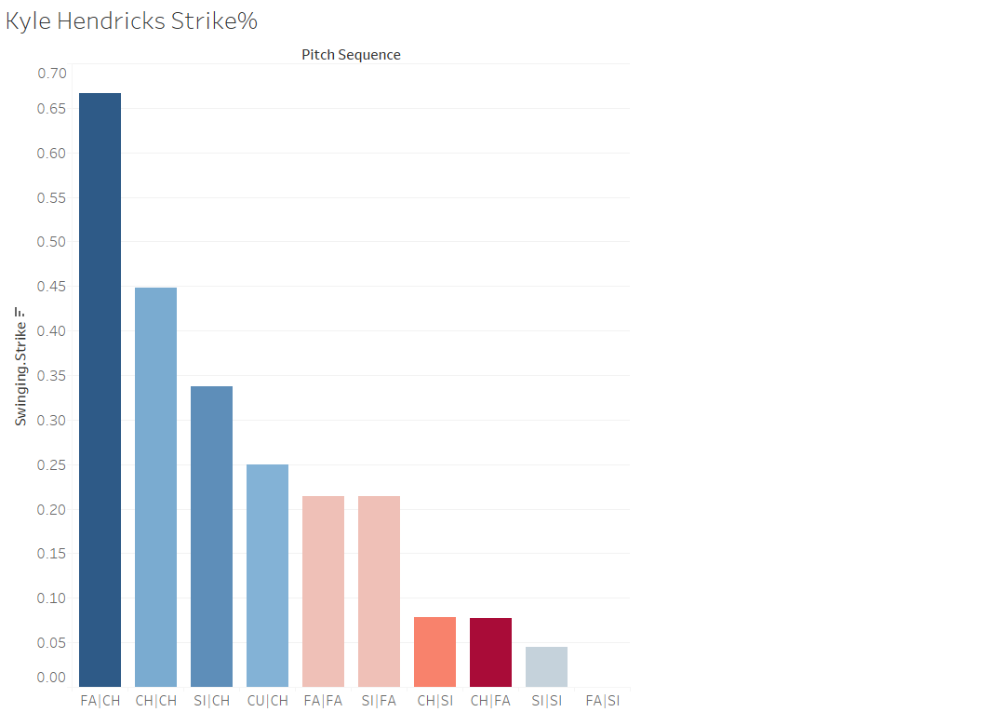
FA|CH = 13.95
CH|CH = 10.08
CU|CH = 13.16
CH|SI = 8.32
Notes:
FA = maybe 92

Slide 12
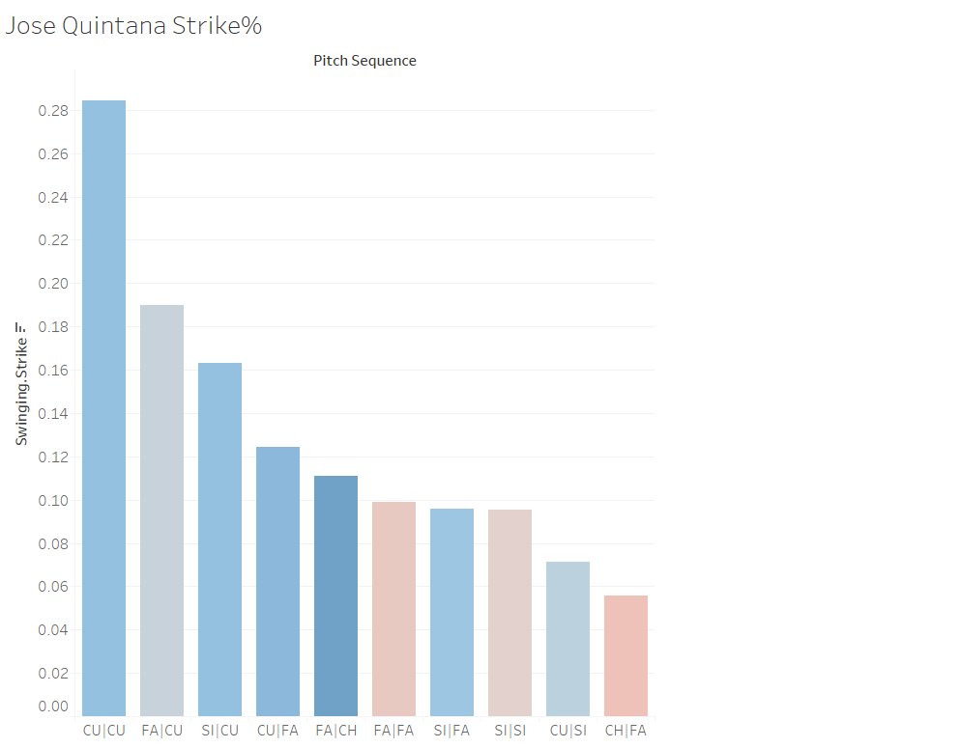
CU|CU = 10.75
FA|CU = 9.53
SI|CU = 8.64
FA|FA = 7.85
Notes:
FA = maybe 92

Slide 13
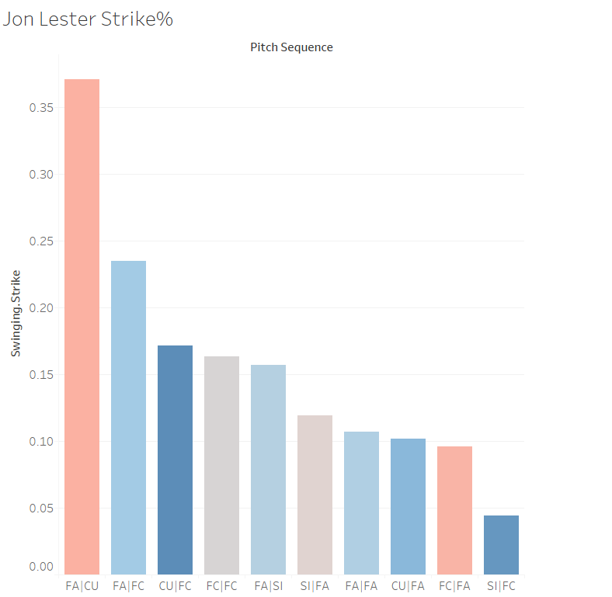
FA|CU = 13.99
FA|FC = 12.37
CU|FC = 11.7
SI|FC = 10.54

Slide 14
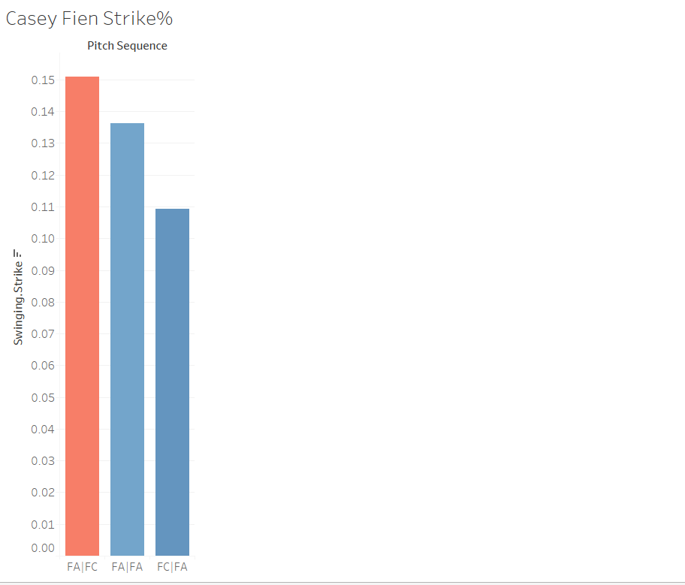
FA|FC = 2.63
FA|FA = 5.91
FC|FA = 2.32

Slide 15
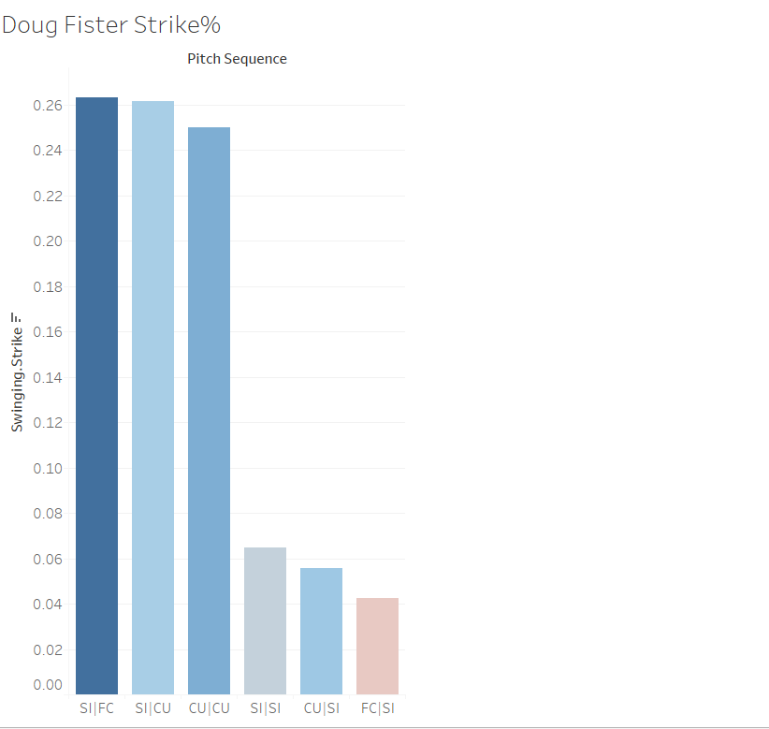
SI|FC = 2.43
SI|CU = 7.22
CU|CU = 9.02
FC|SI = 3.82

Slide 16
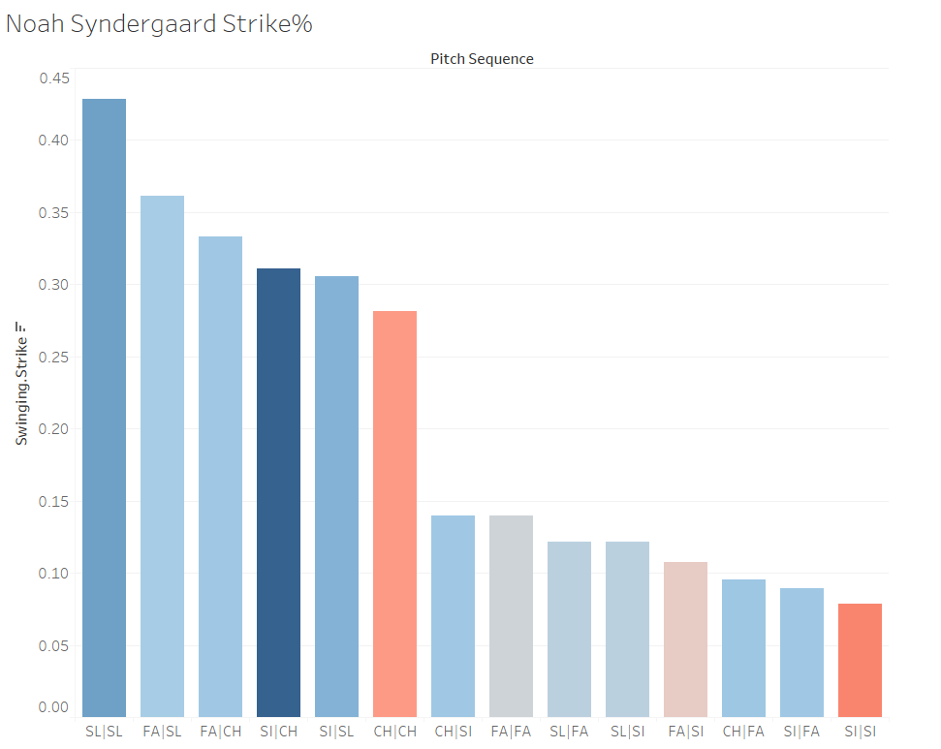
SL|SL = 6.11
FA|SL = 9.54
FA|CH = 4.39
CH|FA = 4.39

Slide 17
Conclusions
Our metric shows strong correlation with a pitcher’s most effective sequence
Was also promising for Quality Contact

Slide 18
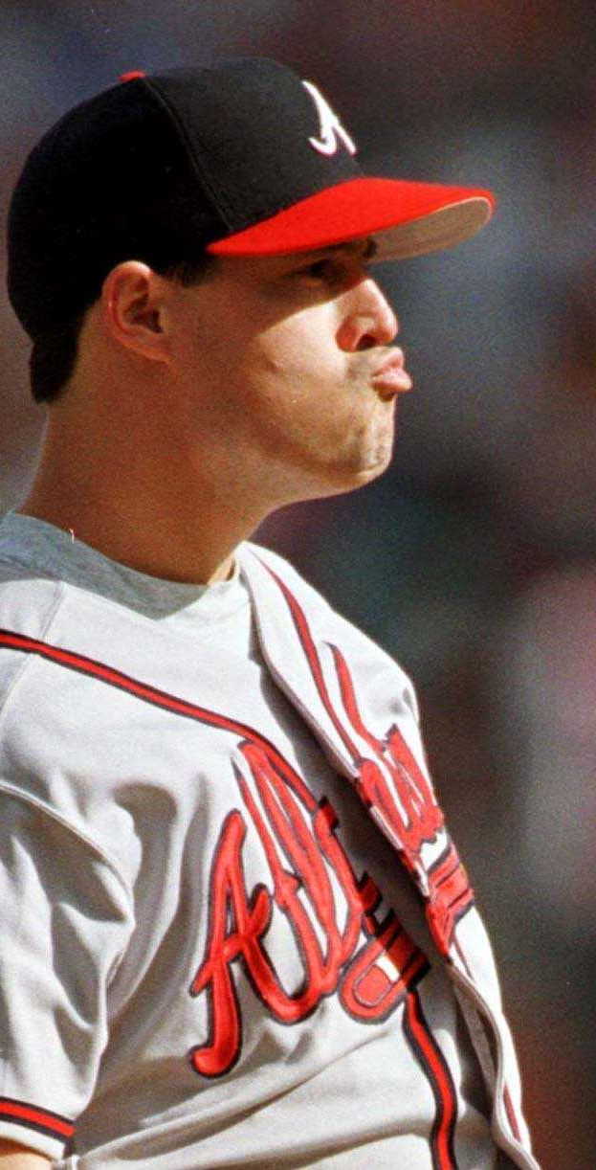
Importance
Allows us to measure the effectiveness of a pitcher to force swinging strikes
Specifically low-velocity pitcher

